Slide 1
Project Definition
Turtle House
Feel at Home Wherever You Go
Team members: Alon Tal, Shay Rosenthal, Yael Shenker

Slide 2
Highlights
Product Name: Turtle House
Product Short Description: Don’t carry your home on your back.
Find a home anywhere in the world.
Users:
Renters, hosts, Admin, guests
Key features:
Renters: search houses anywhere in the world on specified dates, book houses, Review houses, chat with owners.
Hosts: add houses for rent
Guest mode:
Search houses, chat with owners

Slide 3
Main Pages
Home page
Search Form, top houses in recommended locations
List
Preview of all the apartments that fits the filtering, more filter options
Details
Address, reviews, chat, map?, book button, availability calendar?
About
About the app
My Profile
Picture, link to user reservations, link to user houses
User Profile- only hosts
Picture, houses
User Reservations
List of reservation
Favorites
List of favorites
User Houses
List of owned houses
Add House

Slide 4
Page | Description | Routing
Home Page | Search Form Top Rated Houses (List) | /
House Page | Search-bar House cards (List) | /house
House Details | House info Images Offer details Reserve (form) Reviews Map Chat with owner | /house/:id
About Page | About | /about
My Profile | User card About user Links (houses, stays, favorites) | /user/:id
Owner Profile | User card About user | /user/:id
Add House | Form | /addhouse
My Stays | Search bar Stays (List) | /mystay
My Houses | Search bar Houses (List) | /myhouse
My Favorites | Search bar Favorites (List) | /myfavs

Slide 5
Component | Props | Description | Remarks
Search form | Where {} Check in “” Check out”” Guests
House List | Houses | Shows to the user a list of filtered houses according to his request/some initial filter
HousePreview | House | Preview: img, rating, country, house title, link to DetailsPage
Images |  | Gridded images of the chosen house
Offer Details
Reserve Form |  | Reservation Form with a “Reserve” submit-button
Chat |  | Chat between owner and renter | Emits: msg
Map | House cords
ReviewList | House reviews | List of reviews
ReviewPreview | review | Shows review txt, user Full Name, month & year of staying
AddReview | User | Add a new review (available only for users that stayed at the house)

Slide 6

Home Page
Logo
About
Signup/Login
Slogan
Where:__________
Check-in:___
Check-out:___
Guests:__________
Search
Top-rated Places to Stay in
details
details
details
details

Slide 7
House Preview
iIMG
CCountry, City
CHouse Name
CPrice
CRate

Slide 8

House Page
Logo
About
Signup/Login
Search:
Dates
Price
Number of guests
details
details
details
details
details
details
details
details

Slide 9
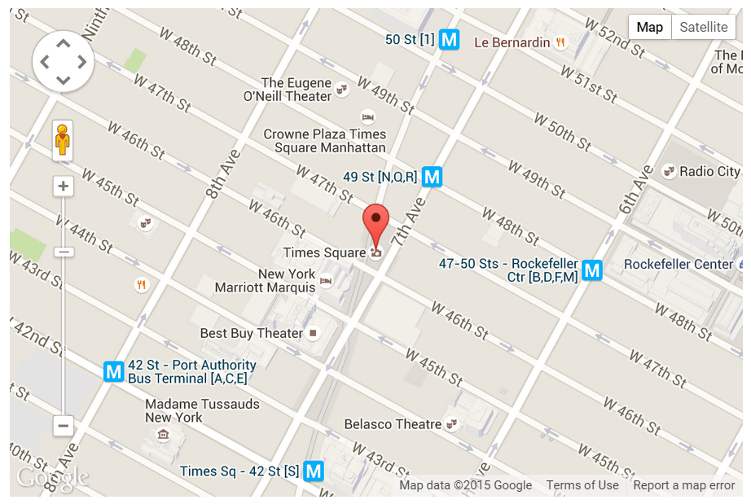
House Details
Logo
About
Search:
Signup/Login
House Info:
Cost: 100$/night
~~~~~~~~~~~~~~~~~~
Rate: 4.5/5
Address: Israel,Tel-aviv.
Book Now!
Reviews
Chat with the owner
Map

Slide 10


About
Logo
About
Signup/Login
About
~~~~~~~~~~~~~~~~~~~~~~~~~~~~~~~~~~~~~~~~~~~~~~~~~~~~~~~~~~~~~~~~~~~~~~~~~~~~~~~~~~~~~~~~~~~~~~~~~~~~~~~~~~~~~~~~~~~~~~~~~~~~~~~~~~~~~~~~~~~~~~~~~~~~~~~~~~~~~~~~~~~~~~~~~~~~~~~~~~~~~~~~~~~~~~~~~~~~~~~~~~~~~~

Slide 11
Owner Profile
Logo
About
Signup/Login
Hi, I’m Shay
About Me: ~~~~~~~~~~~~~~~~~~~~~~~~~~~~~~~~~~
Email:shayke.Rosenthal@gmail.com
Phone:+972 052 123 4567
Houses:
House 1 ,Address:___
House 2 ,Address:___
House 3 ,Address:___

Slide 12
My Profile
Logo
About
Signup/Login
Hi, I’m Shay
About Me: ~~~~~~~~~~~~~~~~~~~~~~~~~~~~~~~~~~
Email:shayke.Rosenthal@gmail.com
Phone:+972 052 123 4567
My Houses:
Link to My Houses
My Stays:
Link to My Stays
My Favorites:
Link to My Favorites

Slide 13
My Stays
Logo
About
Signup/Login
My Stays
Search:
Dates
Recent
Future
details
details
details
details
details
details
details
details

Slide 14
My Houses
Logo
About
Signup/Login
My Houses
details
details
details
details
details
details
details
details

Slide 15
My Favorites
Logo
About
Signup/Login
My Favorites
details
details
details
details
details
details
details
details

Slide 16

Add House
Logo
About
Signup/Login
Add House
Address:________
Guest Capacity:________
Facilities:________
Cost ($/night):________
Add new House

Slide 17



Renter Page Flow
Owner Profile
Home Page
Logo
About
Signup/Login
Logo
About
Hi, I’m Shay
Signup/Login
House Page
About Me: ~~~~~~~~~~~~~~~~~~~~~~~~~~~~~~~~~~
Slogan
Where:__________
Email:shayke.Rosenthal@gmail.com
Check-in:___
Check-out:___
Phone:+972 052 123 4567
Houses:
Guests:__________
Logo
About
Signup/Login
House 1 ,Address:___
House 2 ,Address:___
House 3 ,Address:___
Search
Top-rated Places to Stay in
onClick
Search:
Dates
Price
Number of guests
details
details
details
details
details
details
details
details
onClick
House Details
details
details
details
details
onClick
Logo
About
Search:
Signup/Login
House Info:
Cost: 100$/night
~~~~~~~~~~~~~~~~~~
Rate: 4.5/5
Address: Israel,Tel-aviv.
Book Now!
Reviews
Chat with the owner
Map

Slide 18

Profile Page Flow
My Houses
Logo
About
Signup/Login
Home Page
My Houses
Logo
About
Signup/Login
onClick
Slogan
My Profile
Where:__________
details
details
details
details
Check-in:___
Check-out:___
Guests:__________
Logo
About
Signup/Login
Search
onClick
Top-rated Places to Stay in
Hi, I’m Shay
details
details
details
details
About Me: ~~~~~~~~~~~~~~~~~~~~~~~~~~~~~~~~~~
Email:shayke.Rosenthal@gmail.com
My Houses:
My Stays
details
details
details
details
Phone:+972 052 123 4567
Link to My Houses
My Stays:
onClick
Logo
About
Link to My Stays
Signup/Login
My Favorites:
My Stays
Link to My Favorites
onClick
My Favorites
Search:
Dates
Recent
Future
Logo
About
Signup/Login
details
details
details
details
My Favorites
details
details
details
details
details
details
details
details
details
details
details
details

Slide 19

Owner Page Flow
My Profile
Logo
About
Signup/Login
Hi, I’m Shay
About Me: ~~~~~~~~~~~~~~~~~~~~~~~~~~~~~~~~~~
Add House
Email:shayke.Rosenthal@gmail.com
My Houses:
Logo
About
Phone:+972 052 123 4567
Link to My Houses
Add House
Signup/Login
My Stays:
Add House
Link to My Stays
My Favorites:
Link to My Favorites
Address:________
Guest Capacity:________
My Houses
Facilities:________
Cost ($/night):________
Logo
About
Signup/Login
Add new House
Add House
My Houses
details
details
details
details
details
details
details
details

Slide 20
Model
House
{
"_id": "0p9o8i",
"owner": {
"_id": "0987",
"fullName": "Yael Shenker",
"imgURL": "http://img5.com"
},
"address": {
"country": "Spain",
"city": "Barcelona",
"street": "Ramblas",
"num": "19",
"floor": "1",
"flatNum": "1",
"coords": {
"lat": 0,
"lng": 0
}
},

Slide 21
"imgs": [
"https://img1.com",
"https://img2.com",
"https://img3.com"
],
"capacity": 2,
"numOfRooms": 2,
"numOfbath": 1,
"price": "100$",
"isLift": false,
"isBalcony": false,
"isPetsAllowed": false,
"reviews": [
{
"user": {
"_id": "1234",
"fullName": "shay rosenthal",
"txt": "Amazing place",
"stayDate": "2020-01-15T07:17:01.908Z"
}
}
],
"occupiedDates": [
"2020-01-15T07:17:01.908Z"
]
}

Slide 22
User
{
"_id": "1234",
"fullName": "Alon tal",
"userName": "alontal@gmail.com",
"password": "1q2w3e",
"isHost": false,
"isAdmin": false,
"imgURL": "http://some-img",
"houses": []
}

